Slide 1
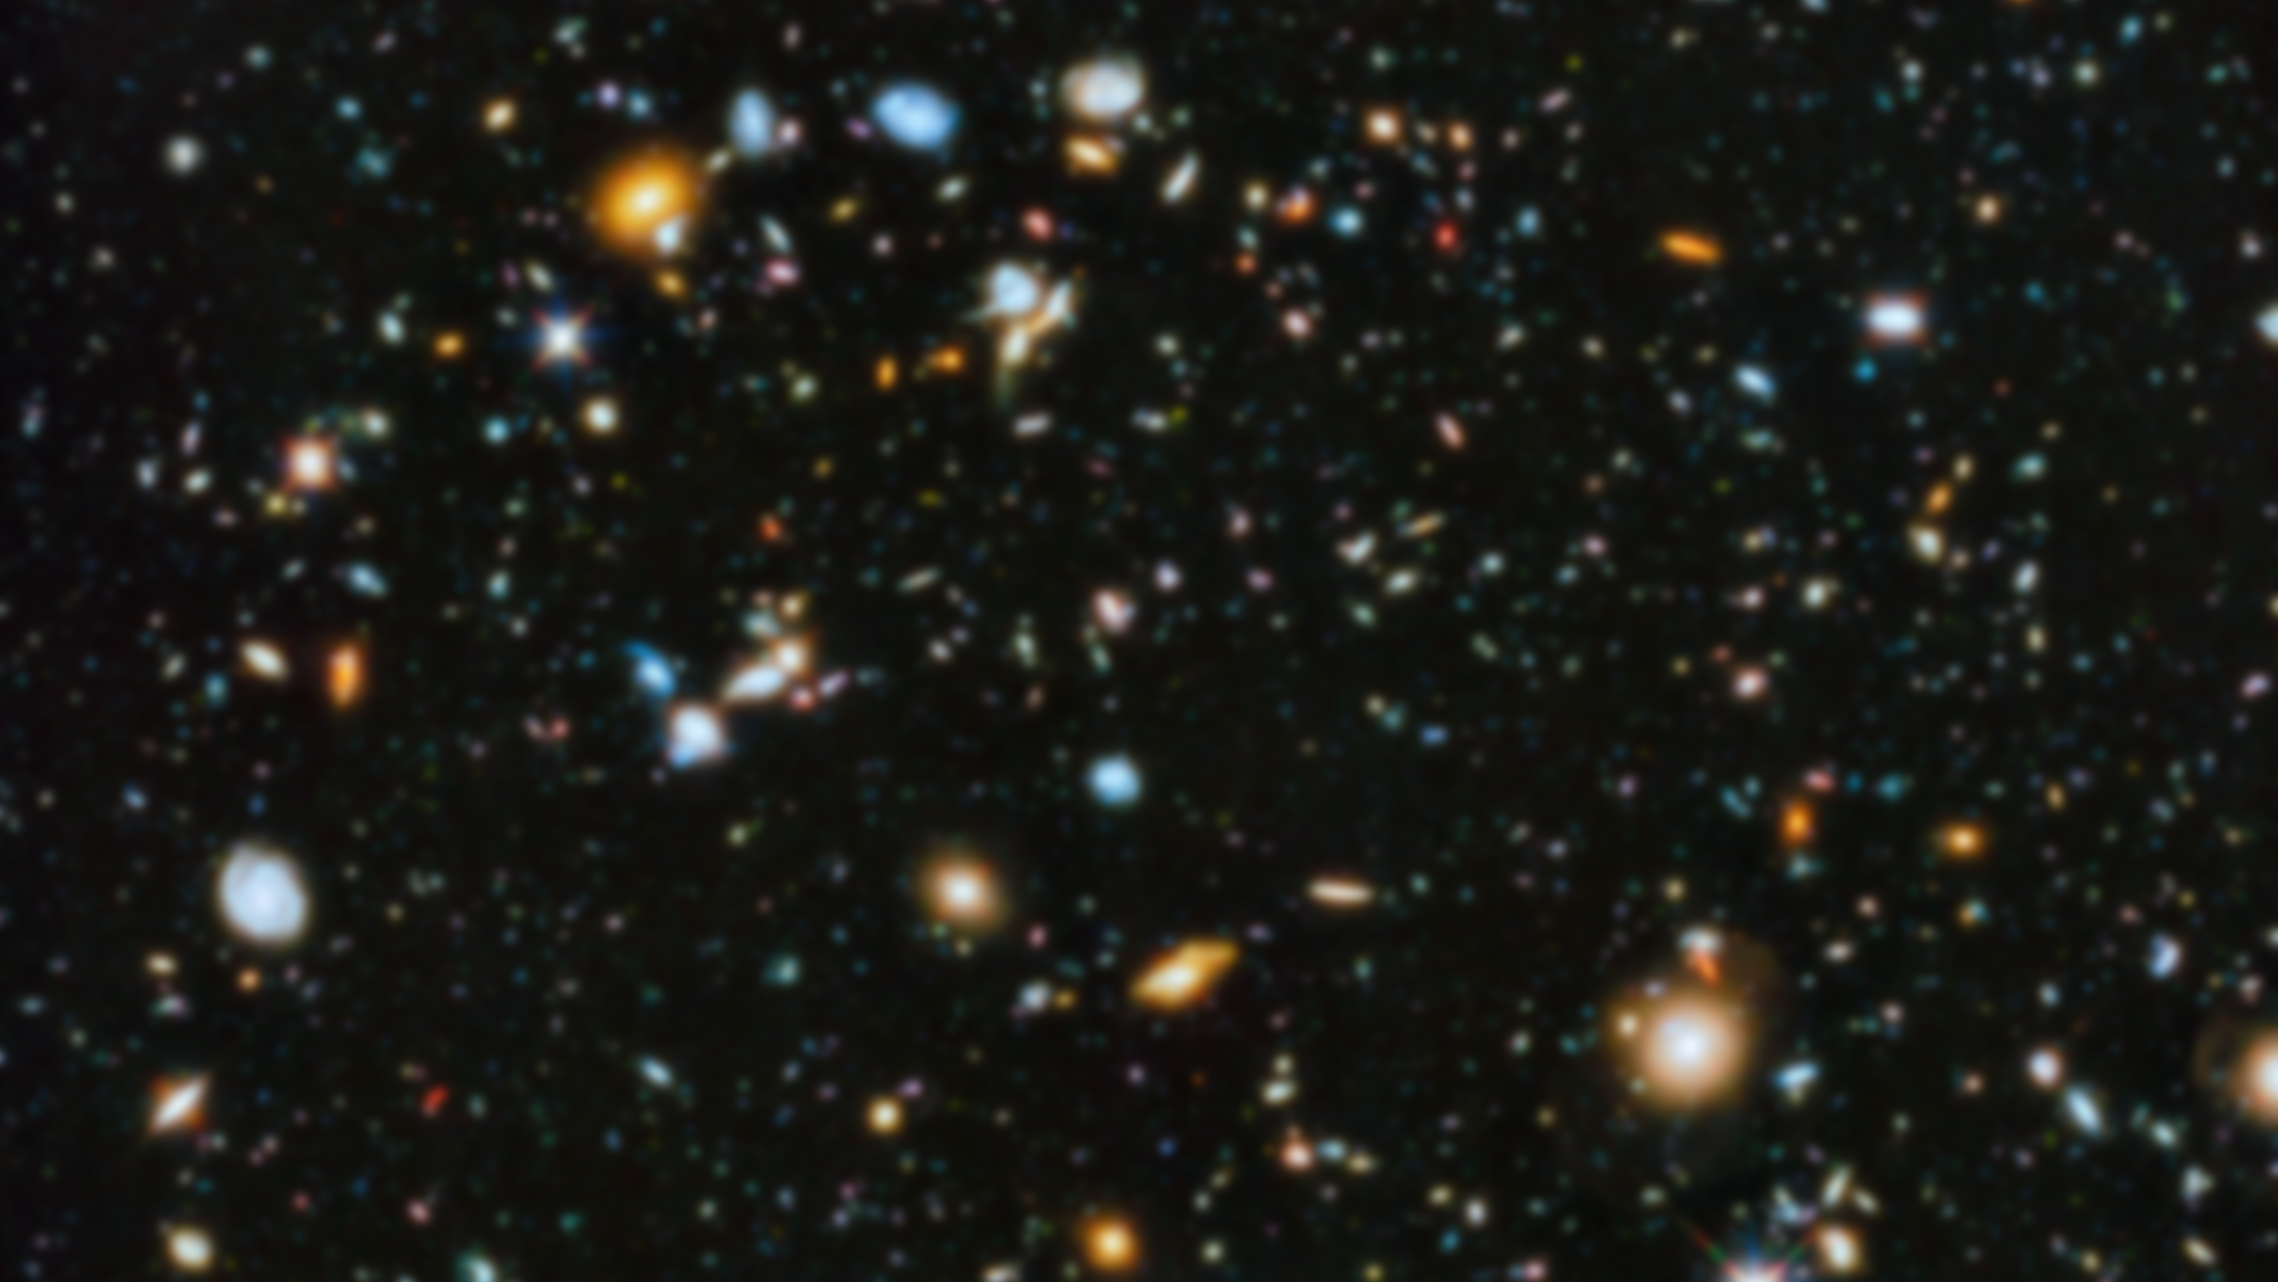
Signed magnitude

Slide 2
r^{n-1} | r^{n-2} | r^{n-3} | … | r² | r¹ | r⁰
0 | Positive Numbers
Nonzero | Negative Numbers
Signed
Magnitude

Slide 3
Give up left most position for sign!
r^{n-1} | r^{n-2} | r^{n-3} | … | r² | r¹ | r⁰
0 | Positive Numbers
Nonzero | Negative Numbers
0 → Max = r^{n-1} -1 = r^{n} -1
Min= - (r^{n-1} -1) ← 0

Slide 4
2⁵ | 2⁴ | 2³ | 2² | 2¹ | 2⁰ |  | Interpretation
0 | 0 | 0 | 0 | 1 | 1 |  | +3
1 | 0 | 0 | 1 | 0 | 1 |  | -5
7⁵ | 7⁴ | 7³ | 7² | 7¹ | 7⁰ |  | Interpretation
0 | 0 | 0 | 0 | 5 | 6 |  | +41
1 | 0 | 0 | 2 | 0 | 5 |  | -103
4 | 0 | 0 | 2 | 0 | 5 |  | -103
6 | 0 | 0 | 2 | 0 | 5 |  | -103

Slide 5
Signed magnitude
arithmetic

Slide 6
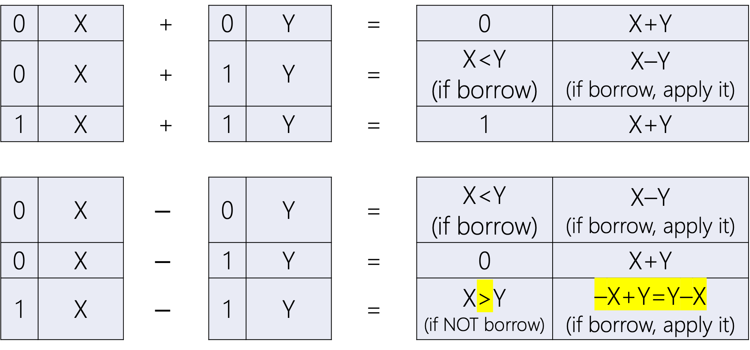
0 | X | + | 0 | Y | = | 0 | X+Y
0 | X | + | 1 | Y | = | X<Y (if borrow) | X–Y (if borrow, apply it)
1 | X | + | 1 | Y | = | 1 | X+Y
0 | X | $$−$$ | 0 | Y | = | X<Y (if borrow) | X–Y (if borrow, apply it)
0 | X | $$−$$ | 1 | Y | = | 0 | X+Y
1 | X | $$−$$ | 1 | Y | = | X>Y (if NOT borrow) | –X+Y=Y–X (if borrow, apply it)

Slide 7
Signed magnitude
Example I

Slide 8
+ Base-16 | 1 | 2 | A | . | E | 5 | 4
 | 1 | B | F | . | 2 | B
 |  |  |  | .

Slide 9
padding
+ Base-16 | 1 | 2 | A | . | E | 5 | 4
 | 1 | B | F | . | 2 | B | 0
 |  |  |  | .

Slide 10
Signed: (–X)+(–Y)=–(X+Y)
+ Base-16 | 1 | 2 | A | . | E | 5 | 4
 | 1 | B | F | . | 2 | B | 0
 | 1 |  |  | .

Slide 11
 |  | 1 | 1 |  | 1
+ Base-16 | 1 | 2 | A=10 | . | E=14 | 5 | 4
 | 1 | B | F=15 | . | 2 | B=11 | 0
 | 1 | E=14 | A=10 | . | 1 | 0 | 4

Slide 12
Signed magnitude
Example II

Slide 13
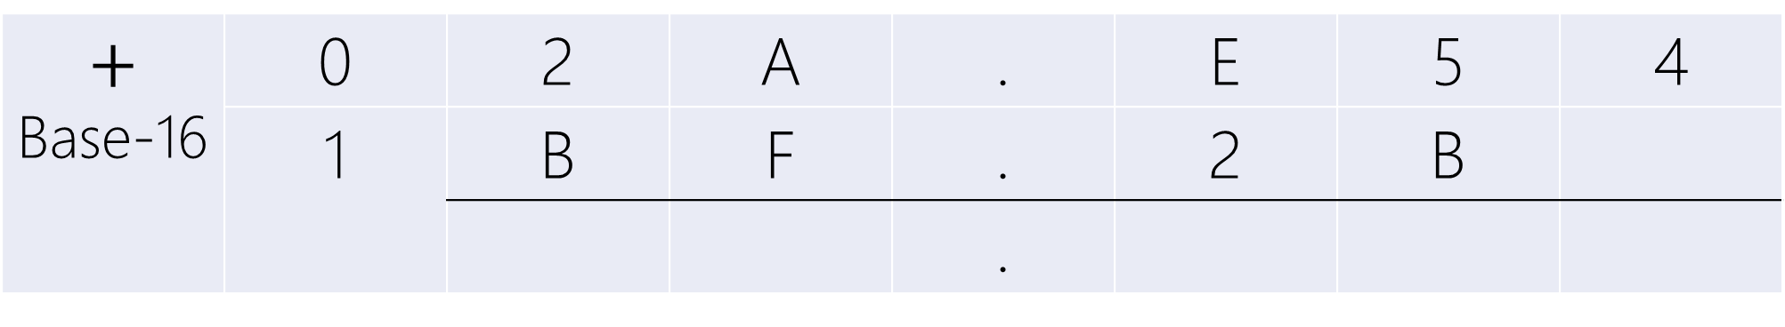
$$+$$ Base-16 | 0 | 2 | A | . | E | 5 | 4
 | 1 | B | F | . | 2 | B
 |  |  |  | .

Slide 14
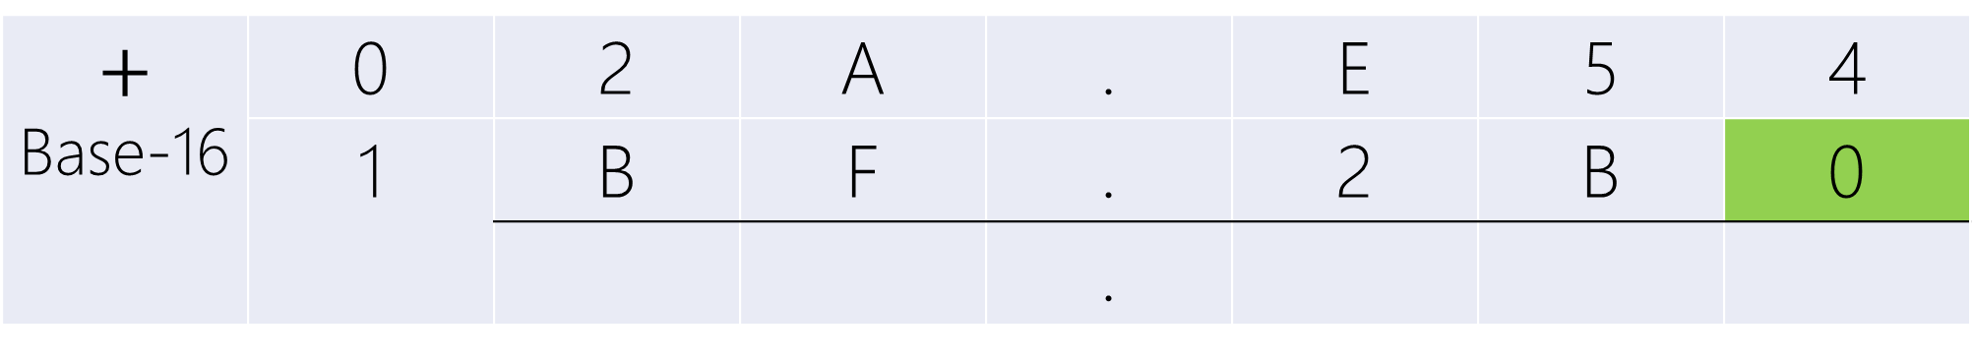
padding
$$+$$ Base-16 | 0 | 2 | A | . | E | 5 | 4
 | 1 | B | F | . | 2 | B | 0
 |  |  |  | .

Slide 15
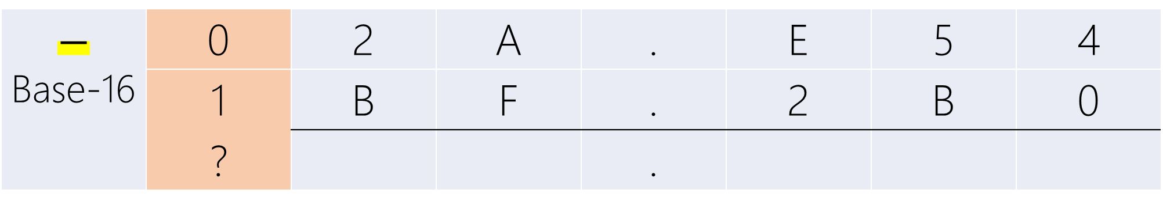
Signed: (+X)+(–Y)=?(X–Y)
$$−$$ Base-16 | 0 | 2 | A | . | E | 5 | 4
 | 1 | B | F | . | 2 | B | 0
 | ? |  |  | .

Slide 16
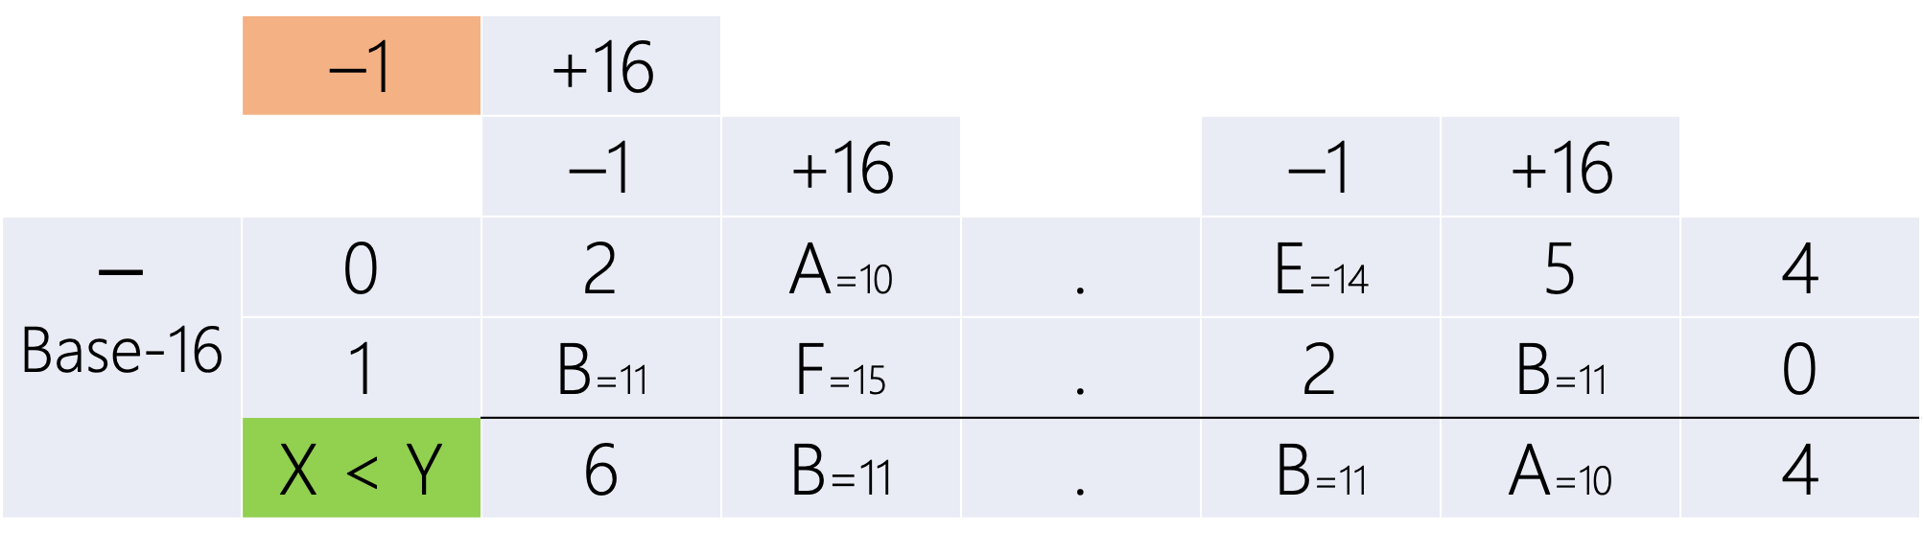
 | –1 | +16
 |  | –1 | +16 |  | –1 | +16
$$−$$ Base-16 | 0 | 2 | A=10 | . | E=14 | 5 | 4
 | 1 | B=11 | F=15 | . | 2 | B=11 | 0
 | X < Y | 6 | B=11 | . | B=11 | A=10 | 4
2A.E54 < BF.2B0
Last Borrow → Negative Result

Slide 17
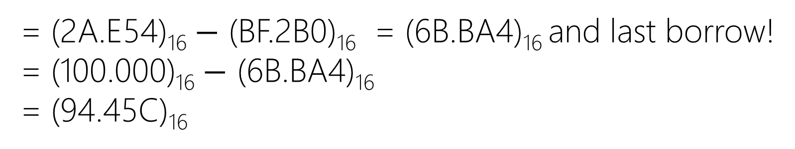
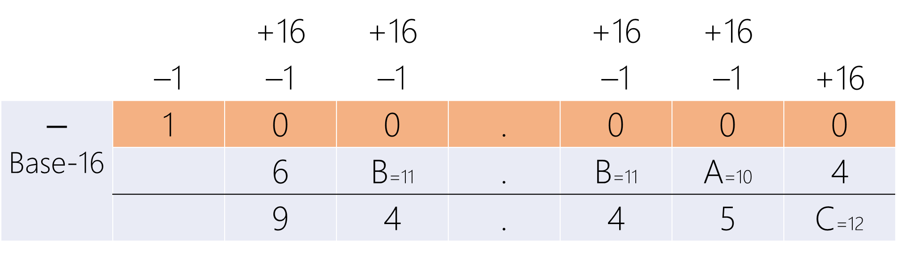
 |  | +16 | +16 |  | +16 | +16
 | –1 | –1 | –1 |  | –1 | –1 | +16
$$−$$ Base-16 | 1 | 0 | 0 | . | 0 | 0 | 0
 |  | 6 | B=11 | . | B=11 | A=10 | 4
 |  | 9 | 4 | . | 4 | 5 | C=12
= (2A.E54)₁₆ $−$ (BF.2B0)₁₆ = (6B.BA4)₁₆ and last borrow!
= (100.000)₁₆ $−$ (6B.BA4)₁₆
= (94.45C)₁₆

Slide 18
 | –1 | +16
 |  | –1 | +16 |  | –1 | +16
$$−$$ Base-16 | 0 | 2 | A=10 | . | E=14 | 5 | 4
 | 1 | B=11 | F=15 | . | 2 | B=11 | 0
 | X < Y | 6 | B=11 | . | B=11 | A=10 | 4
2A.E54 < BF.2B0
Last Borrow → Negative Result
1 | 9 | 4 | . | 4 | 5 | C

Slide 19
Signed magnitude
overflow

Slide 20
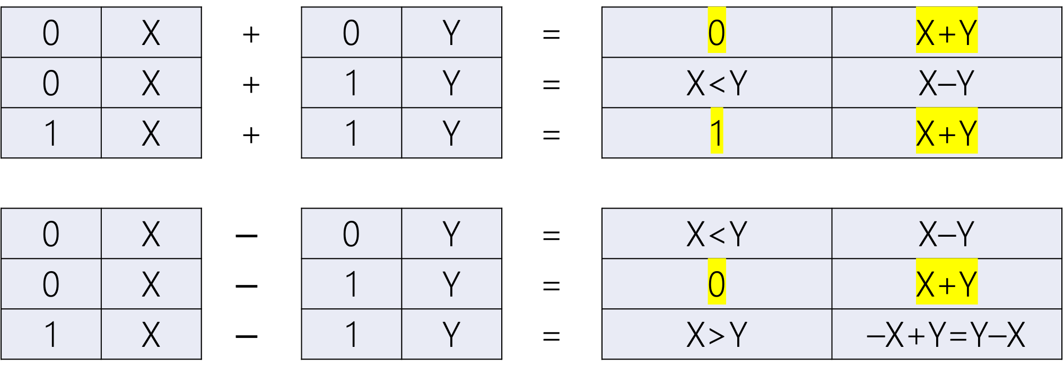
Overflow!
0 | X | + | 0 | Y | = | 0 | X+Y
0 | X | + | 1 | Y | = | X<Y | X–Y
1 | X | + | 1 | Y | = | 1 | X+Y
0 | X | $$−$$ | 0 | Y | = | X<Y | X–Y
0 | X | $$−$$ | 1 | Y | = | 0 | X+Y
1 | X | $$−$$ | 1 | Y | = | X>Y | –X+Y=Y–X

Slide 21
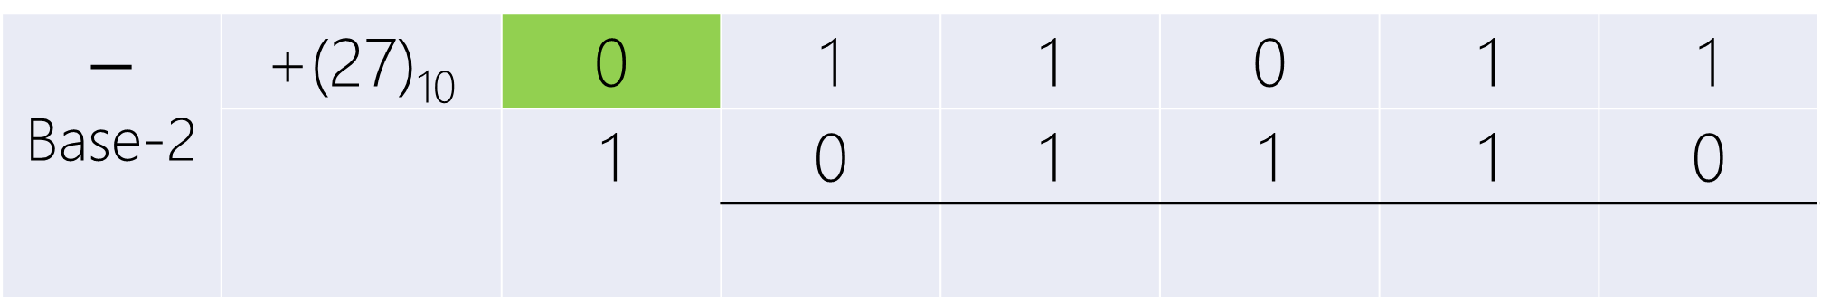
$$−$$ Base-2 | +(27)₁₀ | 0 | 1 | 1 | 0 | 1 | 1
 |  | 1 | 0 | 1 | 1 | 1 | 0

Slide 22
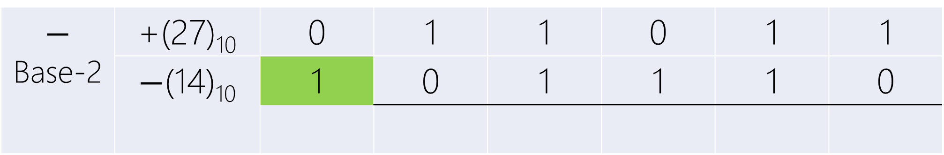
$$−$$ Base-2 | +(27)₁₀ | 0 | 1 | 1 | 0 | 1 | 1
 | $−$(14)₁₀ | 1 | 0 | 1 | 1 | 1 | 0

Slide 23
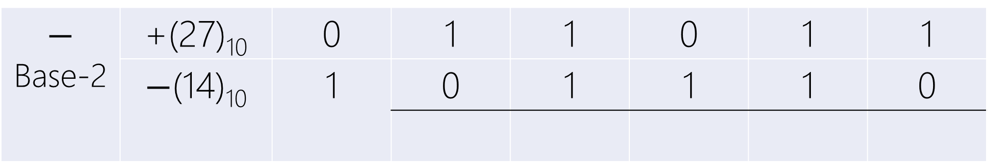
+X – (– Y)
$$−$$ Base-2 | +(27)₁₀ | 0 | 1 | 1 | 0 | 1 | 1
 | $−$(14)₁₀ | 1 | 0 | 1 | 1 | 1 | 0

Slide 24
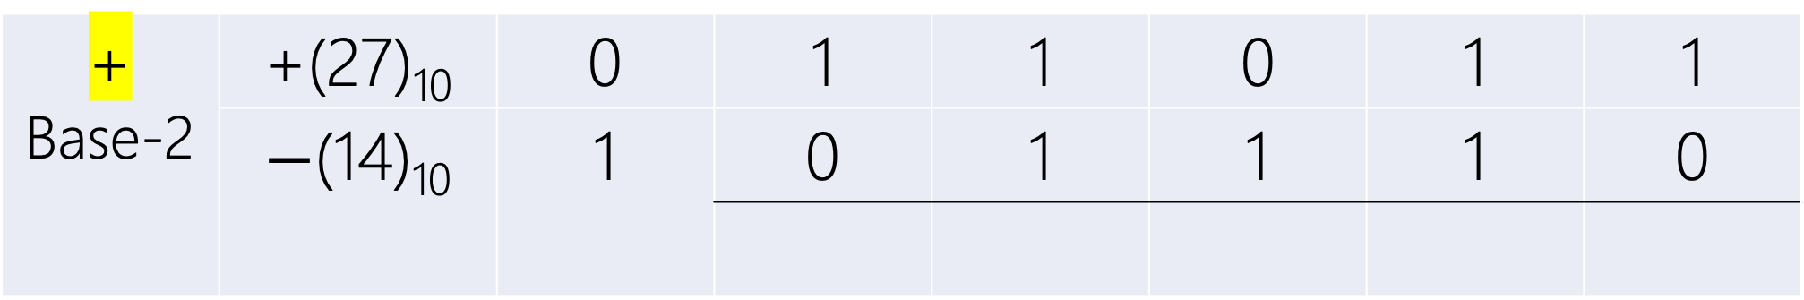
+X – (– Y) = +(X+Y)
$$\text{+}$$ Base-2 | +(27)₁₀ | 0 | 1 | 1 | 0 | 1 | 1
 | $−$(14)₁₀ | 1 | 0 | 1 | 1 | 1 | 0

Slide 25
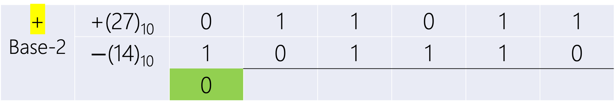
+X – (– Y) = +(X+Y)
$$\text{+}$$ Base-2 | +(27)₁₀ | 0 | 1 | 1 | 0 | 1 | 1
 | $−$(14)₁₀ | 1 | 0 | 1 | 1 | 1 | 0
 |  | 0

Slide 26
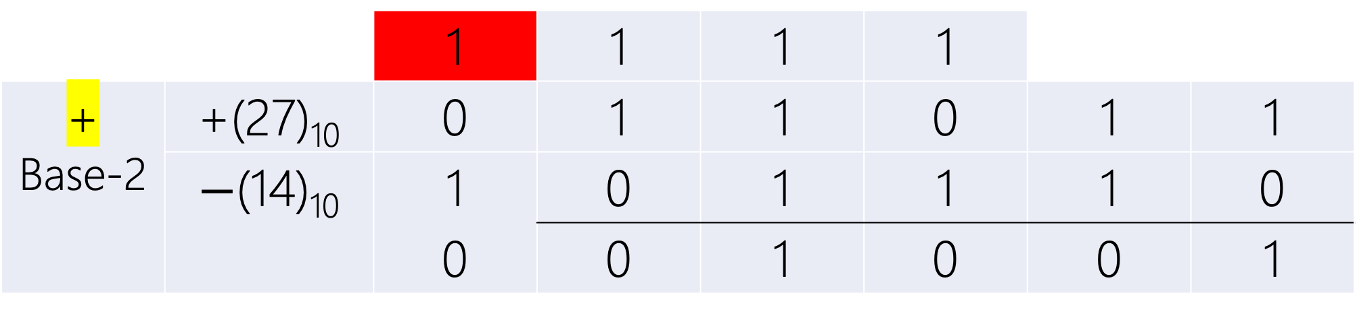
+X – (– Y) = +(X+Y)
 |  | 1 | 1 | 1 | 1
$$\text{+}$$ Base-2 | +(27)₁₀ | 0 | 1 | 1 | 0 | 1 | 1
 | $−$(14)₁₀ | 1 | 0 | 1 | 1 | 1 | 0
 |  | 0 | 0 | 1 | 0 | 0 | 1

Slide 27
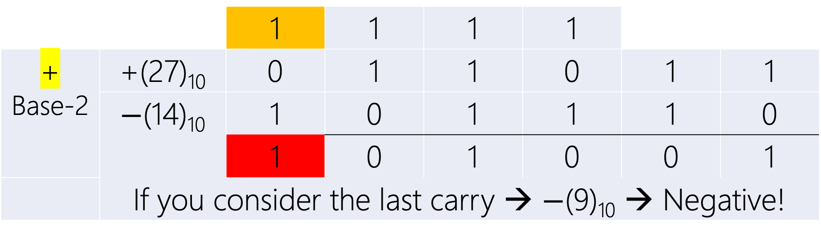
+X – (– Y) = +(X+Y)
 |  | 1 | 1 | 1 | 1
$$\text{+}$$ Base-2 | +(27)₁₀ | 0 | 1 | 1 | 0 | 1 | 1
 | $−$(14)₁₀ | 1 | 0 | 1 | 1 | 1 | 0
 |  | 1 | 0 | 1 | 0 | 0 | 1
 | If you consider the last carry → $−$(9)₁₀ → Negative!

Slide 28
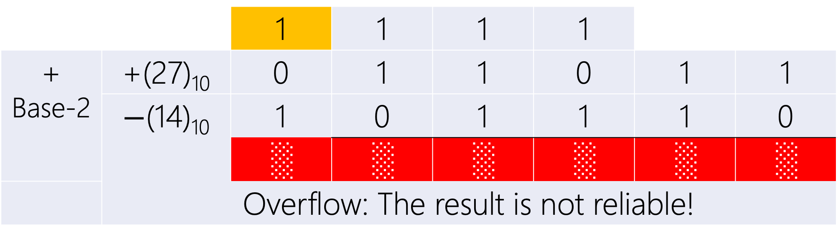
+X – (– Y) = +(X+Y)
 |  | 1 | 1 | 1 | 1
$$\text{+}$$ Base-2 | +(27)₁₀ | 0 | 1 | 1 | 0 | 1 | 1
 | $−$(14)₁₀ | 1 | 0 | 1 | 1 | 1 | 0
 |  | ░ | ░ | ░ | ░ | ░ | ░
 | Overflow: The result is not reliable!

Slide 29
Signed complement

Slide 30
Give up left most position for sign! What are the wastes?
r^{n–1} | r^{n–2} | r^{n–3} | … | r² | r¹ | r⁰
0 | Positive Numbers
Nonzero | Negative Numbers
+0 → Max = r^{n–1} –1 = r^{n} –1
Min= – (r^{n–1} –1) ← –0

Slide 31
Diminished Radix complement

Slide 32
Given (N)_{r} with n digits, the (r − 1)’s complement of N, i.e., its diminished radix complement, is defined as (r^{n} − 1) − N.

Slide 33
1’s comp. Base-2

Slide 34
Base-2 |  | 2⁴ | 2³ | 2² | 2¹ | 2⁰
2⁵= | 1 | 0 | 0 | 0 | 0 | 0

Slide 35
Base-2 |  | 2⁴ | 2³ | 2² | 2¹ | 2⁰
2⁵= | 1 | 0 | 0 | 0 | 0 | 0
1= |  | 0 | 0 | 0 | 0 | 1

Slide 36
Base-2 |  | 2⁴ | 2³ | 2² | 2¹ | 2⁰
 |  | +2 | +2 | +2 | +2
 | –1 | –1 | –1 | –1 | –1 | +2
2⁵= | 1 | 0 | 0 | 0 | 0 | 0
1= |  | 0 | 0 | 0 | 0 | 1
2⁵–1= |  | 1 | 1 | 1 | 1 | 1
 | 5 digits of 1

Slide 37
Base-2 | 2⁵ | 2⁴ | 2³ | 2² | 2¹ | 2⁰
2⁵–1= |  | 1 | 1 | 1 | 1 | 1
N= |  | 1 | 0 | 1 | 0 | 1
(2⁵–1)–N= |  | 0 | 1 | 0 | 1 | 0
1’s complement of (10101)₂=(01010)₂= NOT on each digit

Slide 38
3’s comp. Base-4

Slide 39
Base-4 |  | 4⁴ | 4³ | 4² | 4¹ | 4⁰
4⁵= | 1 | 0 | 0 | 0 | 0 | 0

Slide 40
Base-4 |  | 4⁴ | 4³ | 4² | 4¹ | 4⁰
4⁵= | 1 | 0 | 0 | 0 | 0 | 0
1= | 0 | 0 | 0 | 0 | 0 | 1

Slide 41
Base-4 |  | 4⁴ | 4³ | 4² | 4¹ | 4⁰
 |  | +4 | +4 | +4 | +4
 | –1 | –1 | –1 | –1 | –1 | +4
4⁵= | 1 | 0 | 0 | 0 | 0 | 0
1= |  | 0 | 0 | 0 | 0 | 1
4⁵–1= |  | 3 | 3 | 3 | 3 | 3
 | 5 digits of 3

Slide 42
Base-4 |  | 4⁴ | 4³ | 4² | 4¹ | 4⁰
4⁵–1= |  | 3 | 3 | 3 | 3 | 3
N= |  | 1 | 2 | 1 | 3 | 0
(4⁵–1)–N= |  | 2 | 1 | 2 | 0 | 3
3’s complement of (12130)₄=(21203)₄= 3 – Each digit

Slide 43
9’s comp. Base-10

Slide 44
Base-10 |  | 10⁴ | 10³ | 10² | 10¹ | 10⁰
 |  | +10 | +10 | +10 | +10
 | –1 | –1 | –1 | –1 | –1 | +10
10⁵= | 1 | 0 | 0 | 0 | 0 | 0
1= |  | 0 | 0 | 0 | 0 | 1
10⁵–1= |  | 9 | 9 | 9 | 9 | 9
 | 5 digits of 9

Slide 45
Base-10 |  | 10⁴ | 10³ | 10² | 10¹ | 10⁰
10⁵–1= |  | 9 | 9 | 9 | 9 | 9
N= |  | 1 | 2 | 1 | 3 | 0
(10⁵–1)–N= |  | 8 | 7 | 8 | 6 | 9
9’s complement of (12130)₁₀=(87869)₁₀= 9 – Each digit

Slide 46
(r–1)’s comp. Base-r

Slide 47
Base-r |  | r^{n–1} | … | r² | r¹ | r⁰
r^{n}–1= |  | r–1 | … | r–1 | r–1 | r–1
N= |  | d_{n–1} | … | d₂ | d₁ | d₀
(r^{n}–1)–N= |  | r–1–d_{n–1} | … | r–1–d_{n–1} | r–1–d_{n–1} | r–1–d_{n–1}
(r–1)’s complement of (N)_{r}= (r–1) – Each digit

Slide 48
Radix complement

Slide 49
Given (N)_{r} with n digits, the r’s complement of N, i.e., its radix complement, is defined as r^{n} − N.
Equivalently,
(r–1)’s complement + 1 = [(r^{n} – 1) − N] + 1 = r^{n} − N

Slide 50
2’s comp. Base-2

Slide 51
Base-2 |  | 2⁴ | 2³ | 2² | 2¹ | 2⁰
2⁵–1= |  | 1 | 1 | 1 | 1 | 1
N= |  | 1 | 0 | 1 | 0 | 1
(2⁵–1)–N= |  | 0 | 1 | 0 | 1 | 0
NOT on each digit
+1= |  | 0 | 0 | 0 | 0 | 1
2⁵–N= |  | 0 | 1 | 0 | 1 | 1
2’s complement of (10101)₂=(01010+1)₂= (01011)₂

Slide 52
4’s comp. Base-4

Slide 53
Base-4 |  | 4⁴ | 4³ | 4² | 4¹ | 4⁰
4⁵–1= |  | 3 | 3 | 3 | 3 | 3
N= |  | 1 | 2 | 1 | 3 | 0
(4⁵–1)–N= |  | 2 | 1 | 2 | 0 | 3
Each digit – 3
+1= |  | 0 | 0 | 0 | 0 | 1
4⁵–N= |  | 2 | 1 | 2 | 1 | 0
4’s complement of (12130)₄=(21203+1)₄= (21210)₄

Slide 54
10’s comp. Base-10

Slide 55
Base-10 |  | 10⁴ | 10³ | 10² | 10¹ | 10⁰
10⁵–1= |  | 9 | 9 | 9 | 9 | 9
N= |  | 1 | 2 | 1 | 3 | 0
(10⁵–1)–N= |  | 8 | 7 | 8 | 6 | 9
Each digit – 9
+1= |  | 0 | 0 | 0 | 0 | 1
10⁵–N= |  | 8 | 7 | 8 | 7 | 0
10’s complement of (12130)₁₀=(87869+1)₁₀= (87870)₁₀

Slide 56
r’s comp. Base-r

Slide 57
SIGNED COMPLEMENT

Slide 58
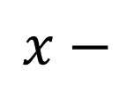
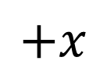
$$x−$$
$$+x$$
 |  |  |  |  |  |  |  |  | –1
0 | 1 | 2 | 3 | 4 | 5 | 6 | 7 | 8 | 9

Slide 59
$$x−$$
$$+x$$
 |  |  |  |  |  |  |  |  | –1
0 | 1 | 2 | 3 | 4 | 5 | 6 | 7 | 8 | 9
–1 = –(10¹–9) = –(10’s comp. 9)= –(9–9+1) = – (9’s comp. 9 + 1)

Slide 60
$$x−$$
$$+x$$
 |  |  |  |  |  |  |  | –2 | –1
0 | 1 | 2 | 3 | 4 | 5 | 6 | 7 | 8 | 9
–2 = –(10¹–8) = –(10’s comp. 8)= –(9–8+1) = – (9’s comp. 8 + 1)

Slide 61
$$x−$$
$$+x$$
 |  |  |  |  |  |  | –3 | –2 | –1
0 | 1 | 2 | 3 | 4 | 5 | 6 | 7 | 8 | 9
–3 = –(10¹–7) = –(10’s comp. 7)= –(9–7+1) = – (9’s comp. 7 + 1)

Slide 62
$$x−$$
$$+x$$
 |  |  |  |  |  | –4 | –3 | –2 | –1
0 | 1 | 2 | 3 | 4 | 5 | 6 | 7 | 8 | 9
–4 = –(10¹–6) = –(10’s comp. 6)= –(9–6+1) = – (9’s comp. 6 + 1)

Slide 63
$$x−$$
$$+x$$
 |  |  |  |  | –5 | –4 | –3 | –2 | –1
0 | 1 | 2 | 3 | 4 | 5 | 6 | 7 | 8 | 9
–5 = –(10¹–5) = –(10’s comp. 5)= –(9–5+1) = – (9’s comp. 5 + 1)

Slide 64
10⁰ | –(10’s comp.) | 10⁰
0 | → | 0
1 |  | –9
2 |  | –8
3 |  | –7
4 |  | –6
5 |  | –5
6 |  | –4
7 |  | –3
8 |  | –2
9 |  | –1

Slide 65
10⁰ | –(10’s comp.) | 10⁰
0 | ← | 0
1 |  | –9
2 |  | –8
3 |  | –7
4 |  | –6
5 |  | –5
6 |  | –4
7 |  | –3
8 |  | –2
9 |  | –1

Slide 66
10⁰ |  | 10⁰
0 | Base-10 Signed 10’s comp. | 0
1 |  | –9
2 |  | –8
3 |  | –7
4 |  | –6
5 |  | –5
6 |  | –4
7 |  | –3
8 |  | –2
9 |  | –1

Slide 67
10⁰ |  | 10⁰
0 | Base-10 Signed 10’s comp. | see 0 interpret 0
1 |  | see 1 interpret 1
2 |  | see 2 interpret 2
3 |  | see 3 interpret 3
4 |  | see 4 interpret 4
5→–5 |  | see 5 interpret –5
6→–4 |  | see 6 interpret –4
7→–3 |  | see 7 interpret –3
8→–2 |  | see 8 interpret –2
9→–1 |  | see 9 interpret –1

Slide 68
SIGNED 10’s COMP. Base-10

Slide 69
Signed Radix Complement Base-10
10^{n–1} | 10^{n–2} | 10^{n–3} |  | … | 10² |  | 10¹ | 10⁰
0 <= |  |  | Positive Numbers |  |  | <= (10^{n} –1)÷2
Nothing to do!

Slide 70
Signed Radix Complement Base-10
10^{n–1} | 10^{n–2} | 10^{n–3} |  | … | 10² |  | 10¹ | 10⁰
(10^{n} –1)÷2 + 1 <= |  |  | Negative Numbers |  |  | <= (10^{n} –1)
Although we see positive numbers, we must interpret them negative! How?

Slide 71
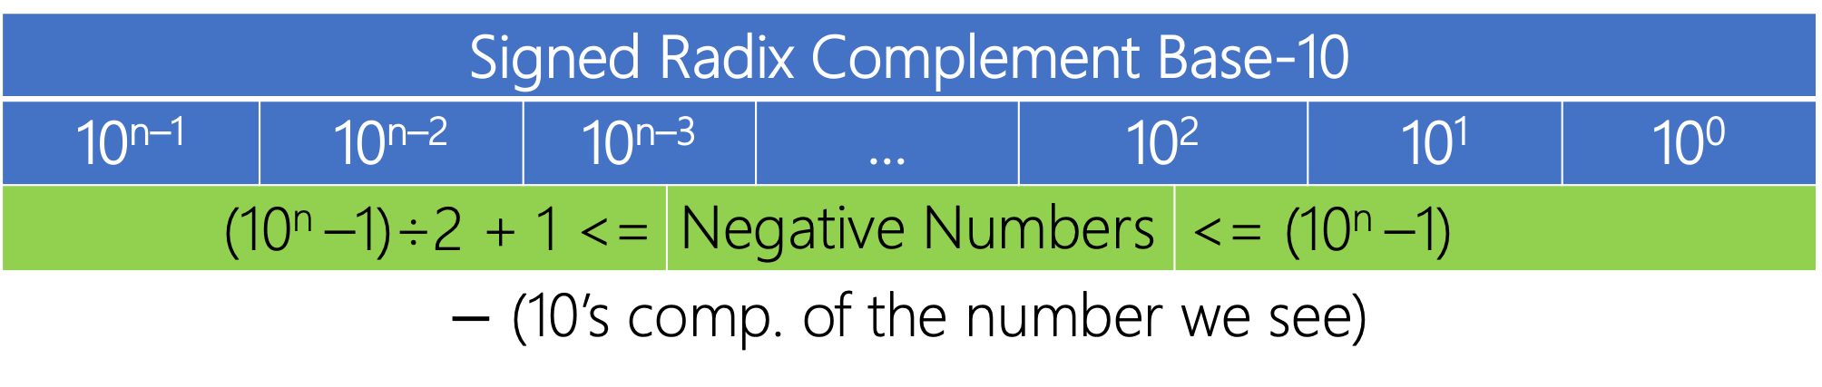
Signed Radix Complement Base-10
10^{n–1} | 10^{n–2} | 10^{n–3} |  | … | 10² |  | 10¹ | 10⁰
(10^{n} –1)÷2 + 1 <= |  |  | Negative Numbers |  |  | <= (10^{n} –1)
$−$ (10’s comp. of the number we see)

Slide 72
Signed Radix Complement Base-10
10⁶ | 10⁵ | 10⁴ | 10³ | 10² | 10¹ | 10⁰
5 | 8 | 0 | 5 | 0 | 7 | 4
n = 7
0 <= | Positive Numbers | <= (10⁷ –1)÷2
(10⁷ –1)÷2 + 1 <= | Negative Numbers | <= (10⁷ –1)

Slide 73
Signed Radix Complement Base-10
10⁶ | 10⁵ | 10⁴ | 10³ | 10² | 10¹ | 10⁰
5 | 8 | 0 | 5 | 0 | 7 | 4
n = 7 (10⁷ –1)÷2 = 9,999,999 ÷ 2 = 4,999,999 5,805,074 > 4,999,999 This number must be interpreted negative!

Slide 74
Signed Radix Complement Base-10
10⁶ | 10⁵ | 10⁴ | 10³ | 10² | 10¹ | 10⁰
5 | 8 | 0 | 5 | 0 | 7 | 4
= – (10’s comp. (5,805,074)) = – (9’s comp. (5,805,074) + 1) = – (9,999,999 – 5,805,074 + 1) = – (4,194,925 + 1) = – (4,194,926)

Slide 75
Signed Radix Complement Base-10
10⁶ | 10⁵ | 10⁴ | 10³ | 10² | 10¹ | 10⁰
X | X | X | X | X | X | X
– 3,450,256

Slide 76
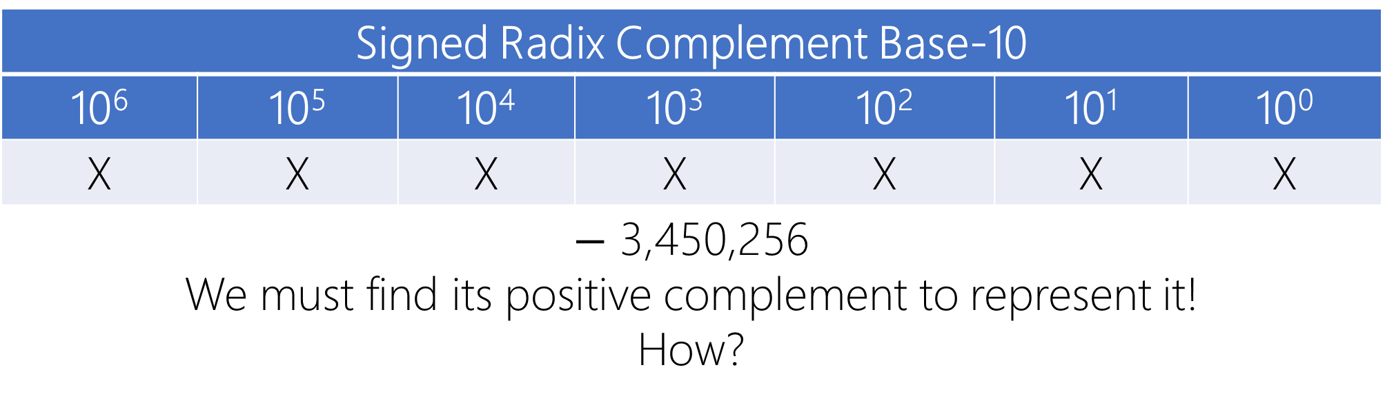
Signed Radix Complement Base-10
10⁶ | 10⁵ | 10⁴ | 10³ | 10² | 10¹ | 10⁰
X | X | X | X | X | X | X
$−$ 3,450,256 We must find its positive complement to represent it! How?

Slide 77
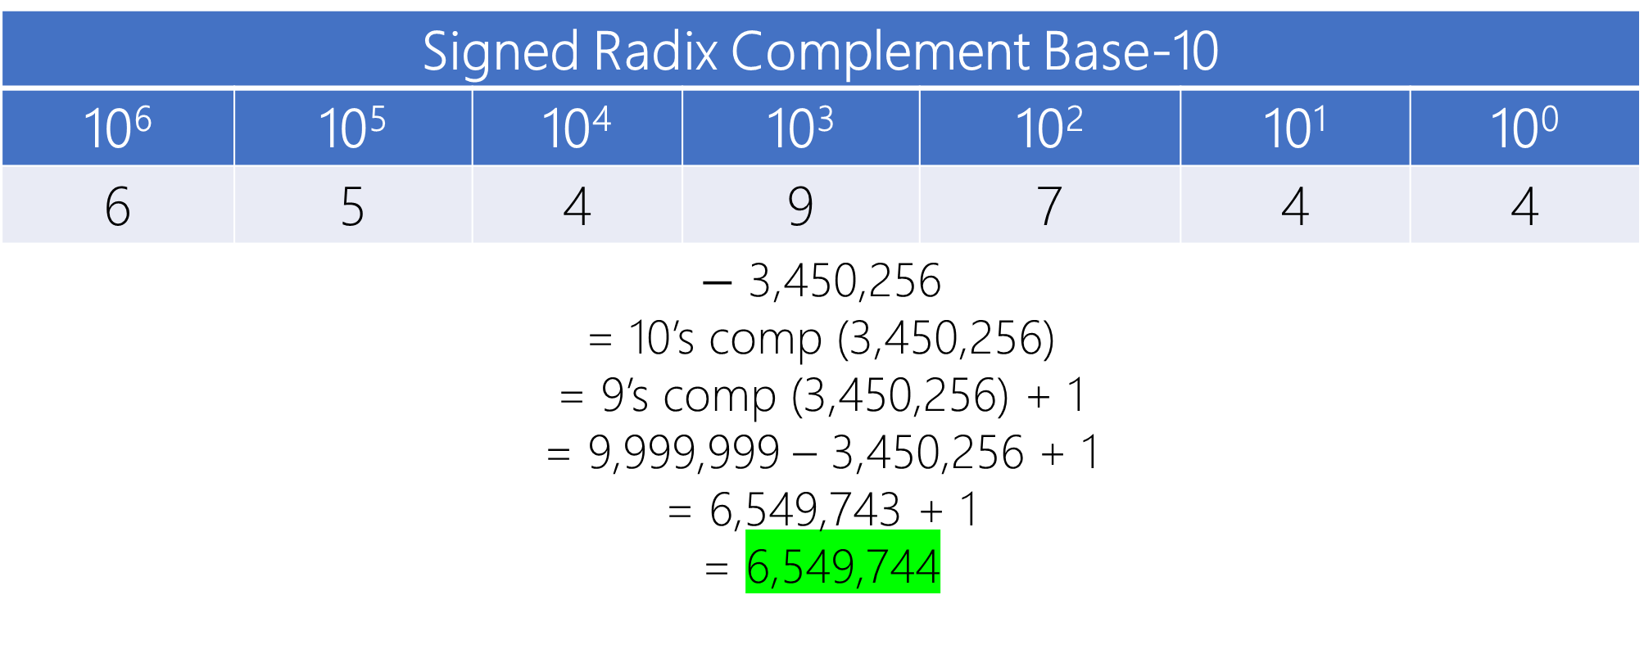
Signed Radix Complement Base-10
10⁶ | 10⁵ | 10⁴ | 10³ | 10² | 10¹ | 10⁰
6 | 5 | 4 | 9 | 7 | 4 | 4
$−$ 3,450,256 = 10’s comp (3,450,256) = 9’s comp (3,450,256) + 1 = 9,999,999 – 3,450,256 + 1 = 6,549,743 + 1 = 6,549,744

Slide 78
SIGNED 16’s COMP. Base-16

Slide 79
Base-16 | 1 | B | F | 2 | B | 4
 | Is this a negative number or positive?

Slide 80
Base-16 | 1 | B | F | 2 | B | 4
 | How many positions? n = 6

Slide 81
Base-16 | 1 | B | F | 2 | B | 4
 | What is the maximum positive number? (16⁶–1)÷2 =(8,388,607)₁₀ = (7FF,FFF)₁₆

Slide 82
Base-16 | 1 | B | F | 2 | B | 4
 | This number is less than (7FF,FFF)₁₆ (+1BF,2B4)₁₆

Slide 83
Base-16 | E | B | F | 2 | B | 4
 | Is this a negative number or positive?

Slide 84
Base-16 | E | B | F | 2 | B | 4
 | How many positions? n = 6

Slide 85
Base-16 | E | B | F | 2 | B | 4
 | What is the maximum positive number? (16⁶–1)÷2 =(8,388,608)₁₀ = (7FF,FFF)₁₆

Slide 86
Base-16 | E | B | F | 2 | B | 4
 | This number is greater than (7FF,FFF)₁₆ The number is negative, but what is the number?

Slide 87
Base-16 | E | B | F | 2 | B | 4
 | = – (16’s comp. (EBF,2B4)) = – (15’s comp. (EBF,2B4) + 1) = – (FFF,FFF – EBF2B4 + 1) = – (140,D4B + 1) = – (140,D4C)

Slide 88
Base-16 | X | X | X | X | X | X
 | – (140,D4C)

Slide 89
Base-16 | X | X | X | X | X | X
 | – 140,D4C = 16’s comp(140,D4C) = 15’s comp(140,D4C) + 1 = FFF,FFF – 140,D4C + 1 = EBF,2B3 + 1 = EBF,2B4

Slide 90
Base-16 | E | B | F | 2 | B | 4
 | – 140,D4C = 16’s comp(140,D4C) = 15’s comp(140,D4C) + 1 = FFF,FFF – 140,D4C + 1 = EBF,2B3 + 1 = EBF,2B4

Slide 91
SIGNED r’s COMP. Base-r

Slide 92
Base-r in Radix Complement
r^{n–1} | r^{n–2} | r^{n–3} |  | … | r² |  | r¹ | r⁰
0 <= |  |  | Positive Numbers Nothing to do! |  |  | <= (r^{n} –1)÷2 Base-2: 0,111,…,111 Base-4: 1,333,…,333 Base-8: 3,777,…,777 Base-10: 4,999,…,999 Base-16: 7,FFF,…,FFF

Slide 93
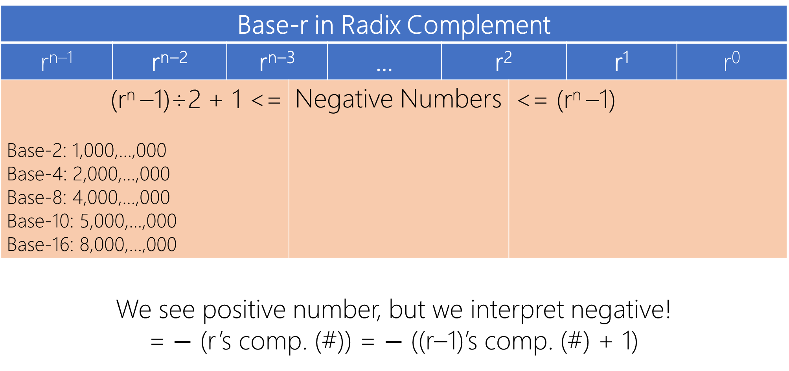
Base-r in Radix Complement
r^{n–1} | r^{n–2} | r^{n–3} |  | … | r² |  | r¹ | r⁰
(r^{n} –1)÷2 + 1 <= Base-2: 1,000,…,000 Base-4: 2,000,…,000 Base-8: 4,000,…,000 Base-10: 5,000,…,000 Base-16: 8,000,…,000 |  |  | Negative Numbers |  |  | <= (r^{n} –1)
We see positive number, but we interpret negative! = $−$ (r’s comp. (#)) = $−$ ((r–1)’s comp. (#) + 1)

Slide 94
Signed r’s complement
arithmetic

Slide 95
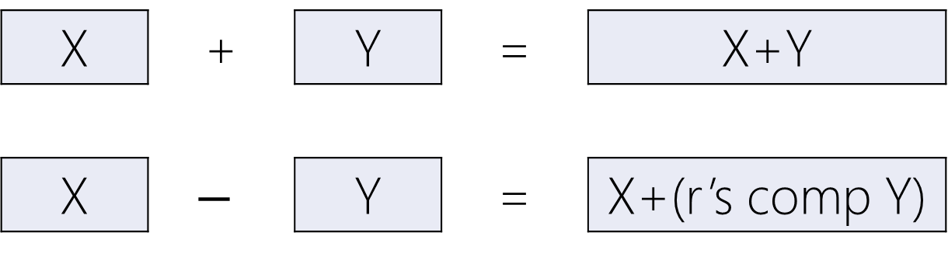
X | + | Y | = | X+Y
X | $$−$$ | Y | = | X+(r’s comp Y)
Last Carry → Ignore

Slide 96
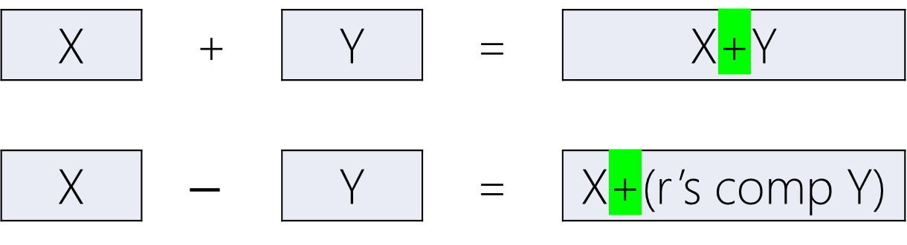
X | + | Y | = | X+Y
X | $$−$$ | Y | = | X+(r’s comp Y)
One adder for both addition and subtraction!

Slide 97
Signed r’s complement
addition

Slide 98
+ Base-2 |  | 1 | 0 | 1 | 0 | 1 | 1
 |  | 0 | 0 | 1 | 1 | 1 | 0

Slide 99
+ Base-2 |  | 1 | 0 | 1 | 0 | 1 | 1
 |  | > (2⁶–1)÷2 = (011,111)₂ = –(2’s comp(#)) = –(010101)₂ = –(21)₁₀

Slide 100
+ Base-2
 |  | 0 | 0 | 1 | 1 | 1 | 0
 |  | < (2⁶–1)÷2 = (011,111)₂ = +(001110)₂

Slide 101
 |  |  | 1 | 1 | 1
+ Base-2 | –(21)₁₀ | 1 | 0 | 1 | 0 | 1 | 1
 | +(14)₁₀ | 0 | 0 | 1 | 1 | 1 | 0
 |  | 1 | 1 | 1 | 0 | 0 | 1

Slide 102
 |  |  | 1 | 1 | 1
+ Base-2 | –(21)₁₀ | 1 | 0 | 1 | 0 | 1 | 1
 | +(14)₁₀ | 0 | 0 | 1 | 1 | 1 | 0
 |  | 1 | 1 | 1 | 0 | 0 | 1
 |  | > (2⁶–1)÷2 = (011,111)₁₀ = –(2’s comp(#)) = –(000111)₂ = –(7)₁₀

Slide 103
Signed r’s complement
subtraction

Slide 104
– Base-2 | –(21)₁₀ | 1 | 0 | 1 | 0 | 1 | 1
 |  | 0 | 0 | 1 | 1 | 1 | 0

Slide 105
– Base-2 | –(21)₁₀ | 1 | 0 | 1 | 0 | 1 | 1
 | +(8)₁₀ | 0 | 0 | 1 | 0 | 0 | 0
 |  | We must convert the subtraction to addition. Eq., addition with – (8)₁₀!

Slide 106
– Base-2 | –(21)₁₀ | 1 | 0 | 1 | 0 | 1 | 1
 | +(8)₁₀ | 0 | 0 | 1 | 0 | 0 | 0
 |  | = – (2’s comp. (001000)) = – (1’s comp(001000) + 1) = – (NOT(001000) + 1) = – (110111 + 1) = – (111000)

Slide 107
+ Base-2 | –(21)₁₀ | 1 | 0 | 1 | 0 | 1 | 1
 | –(8)₁₀ | 1 | 1 | 1 | 0 | 0 | 0

Slide 108
Last Carry → Ignore
 | 1 | 1 | 1
+ Base-2 | –(21)₁₀ | 1 | 0 | 1 | 0 | 1 | 1
 | –(8)₁₀ | 1 | 1 | 1 | 0 | 0 | 0
 |  | 1 | 0 | 0 | 0 | 1 | 1

Slide 109
 |  | 1 | 1
+ Base-2 | –(21)₁₀ | 1 | 0 | 1 | 0 | 1 | 1
 | –(8)₁₀ | 1 | 1 | 1 | 0 | 0 | 0
 |  | 1 | 0 | 0 | 0 | 1 | 1
 |  | Done! This is the Result.

Slide 110
 |  | 1 | 1
+ Base-2 | –(21)₁₀ | 1 | 0 | 1 | 0 | 1 | 1
 | –(8)₁₀ | 1 | 1 | 1 | 0 | 0 | 0
 |  | 1 | 0 | 0 | 0 | 1 | 1
 |  | > 2⁶–1÷2 = (011,111)₁₀ The number is negative: = – (2’s comp. (100011)) = –(011101)

Slide 111
 |  | 1 | 1
+ Base-2 | –(21)₁₀ | 1 | 0 | 1 | 0 | 1 | 1
 | –(8)₁₀ | 1 | 1 | 1 | 0 | 0 | 0
 | –(29)₁₀ | 1 | 0 | 0 | 0 | 1 | 1

Slide 112
Signed r’s complement
overflow

Slide 113
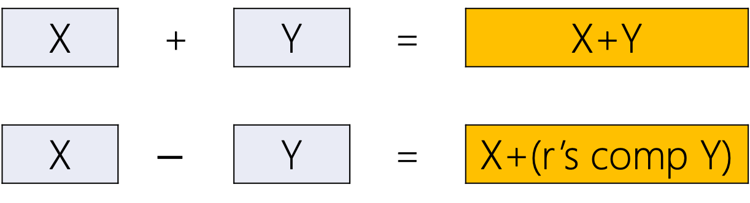
X | + | Y | = | X+Y
X | $$−$$ | Y | = | X+(r’s comp Y)
The + result of two negative numbers → positive
The + result of two positive numbers → negative

Slide 114
– Base-2 | –(21)₁₀ | 1 | 0 | 1 | 0 | 1 | 1
 |  | 0 | 0 | 1 | 1 | 1 | 0

Slide 115
– Base-2 | –(21)₁₀ | 1 | 0 | 1 | 0 | 1 | 1
 | +(14)₁₀ | 0 | 0 | 1 | 1 | 1 | 0
 |  | We must convert the subtraction to addition. Eq., addition with – (14)₁₀!

Slide 116
– Base-2 | –(21)₁₀ | 1 | 0 | 1 | 0 | 1 | 1
 | +(14)₁₀ | 0 | 0 | 1 | 1 | 1 | 0
 |  | = – (2’s comp. (001110)) = – (1’s comp(001110) + 1) = – (NOT(001110) + 1) = – (110001 + 1) = – (110010)

Slide 117
+ Base-2 | –(21)₁₀ | 1 | 0 | 1 | 0 | 1 | 1
 | –(14)₁₀ | 1 | 1 | 0 | 0 | 1 | 0

Slide 118
Last Carry → Ignore
 | 1 |  |  |  | 1
+ Base-2 | –(21)₁₀ | 1 | 0 | 1 | 0 | 1 | 1
 | –(14)₁₀ | 1 | 1 | 0 | 0 | 1 | 0
 |  | 0 | 1 | 1 | 1 | 0 | 1

Slide 119
 |  |  |  |  | 1
+ Base-2 | –(21)₁₀ | 1 | 0 | 1 | 0 | 1 | 1
 | –(14)₁₀ | 1 | 1 | 0 | 0 | 1 | 0
 |  | 0 | 1 | 1 | 1 | 0 | 1
 |  | < 2⁶–1÷2 = (011,111)₁₀ = +(011101)₂

Slide 120
 |  |  |  |  | 1
+ Base-2 | –(21)₁₀ | 1 | 0 | 1 | 0 | 1 | 1
 | –(14)₁₀ | 1 | 1 | 0 | 0 | 1 | 0
 |  | ░ | ░ | ░ | ░ | ░ | ░
 |  | Overflow! Don’t rely on the result!

Slide 121
Binary code
Will be covered later. Stay tuned!

